Slide 1


Slide 2
Problems :
Facebook
Twitter
YouTube
LinkedIn
Advertisements in comments:

Slide 3
Task :
Identify Comments
1
Train a model that can identify the label of the comment based upon it’s features.
2
Prediction
Based on the model we predict the class of the comment i.e. whether it’s Ad or not

Slide 4
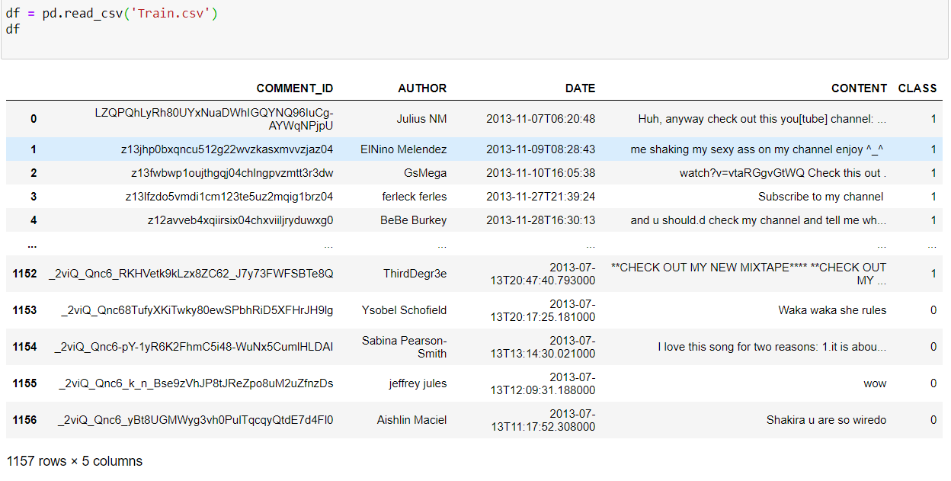
Data Analysis
0
1
Not an Advertisement
Advertisement

Slide 5
Machine Learning Life Cycle
Data Understanding
Choose the Model
Testing Deployment
It involves complete analysis of data and collect key points about the model.
Choosing the right model for given problem
Test the model for accuracy and deploy it
Lower casing, Stop words removal, Lemmatization, Vectorization and Tokenization
Data Preprocessing
Build, Train the model
Feed the data in the model and train it

Slide 6


Slide 7

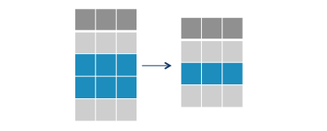
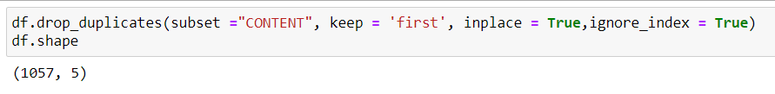
Duplicate Data
Duplicates in the Dataset
Remove Duplicate Data

Slide 8

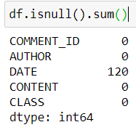
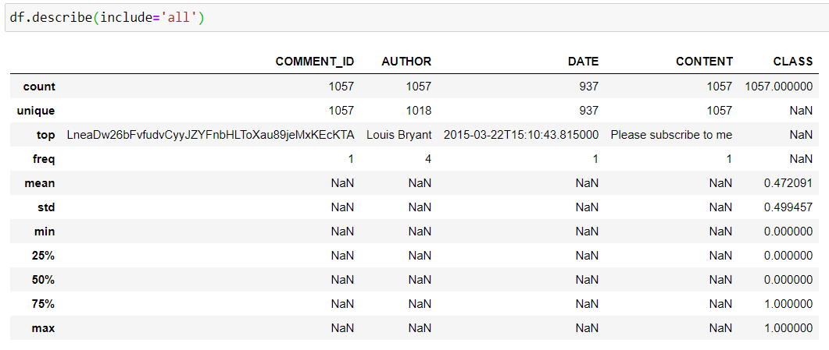
Description of Data

Slide 9

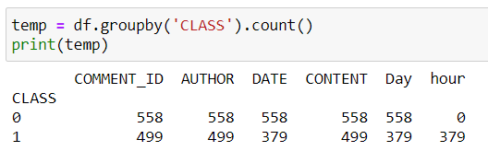
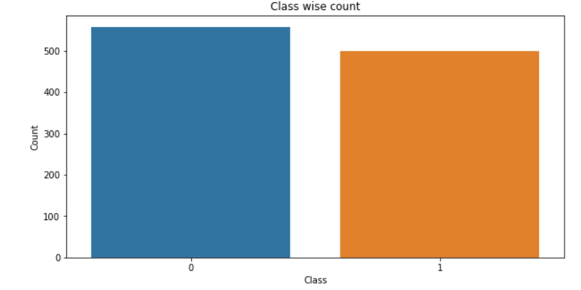
Class Count

Slide 10
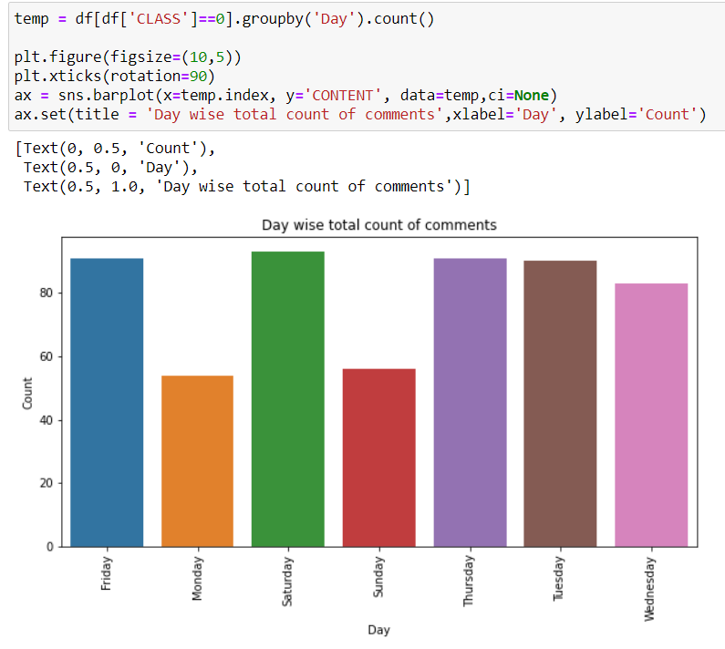
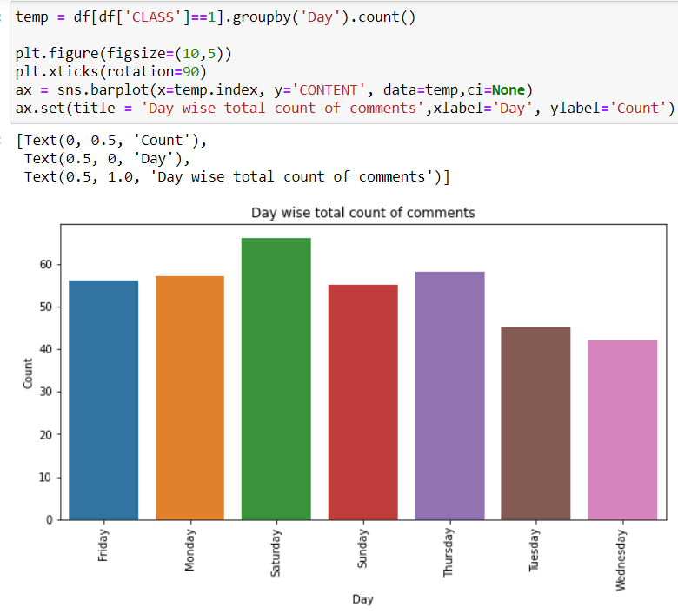
Day wise Analysis of Comments
No Advertisement
Advertisement

Slide 11
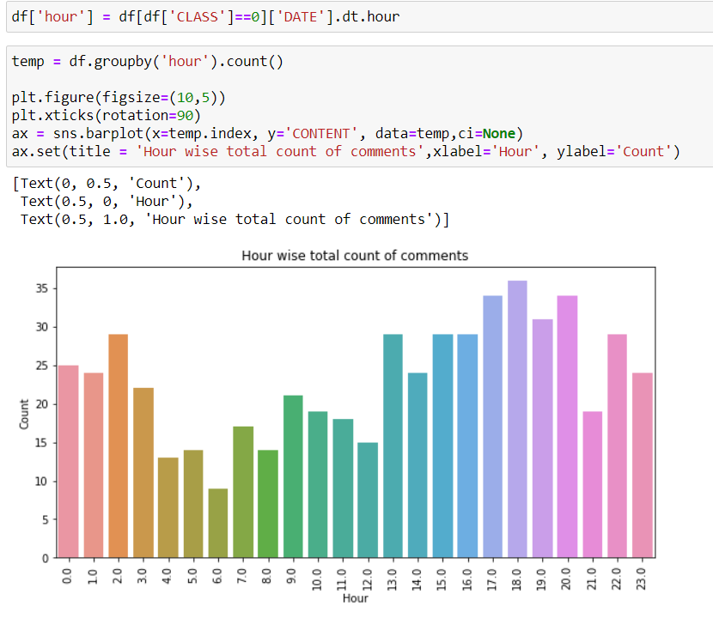
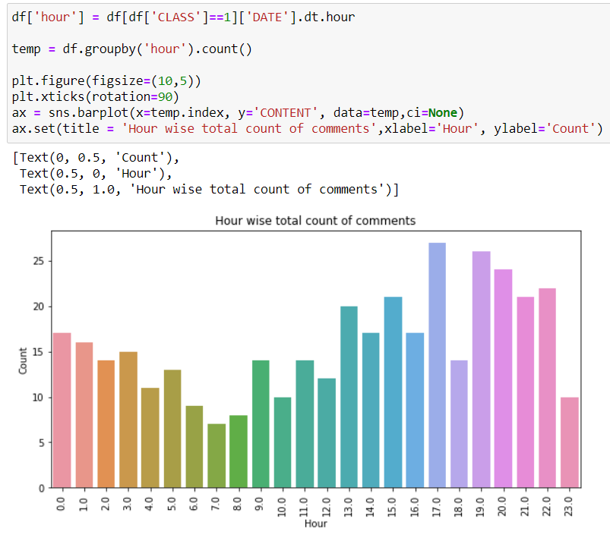
Hour wise Analysis of Comments
No Advertisement
Advertisement

Slide 12
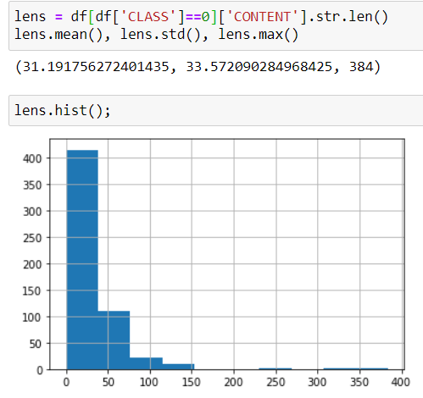
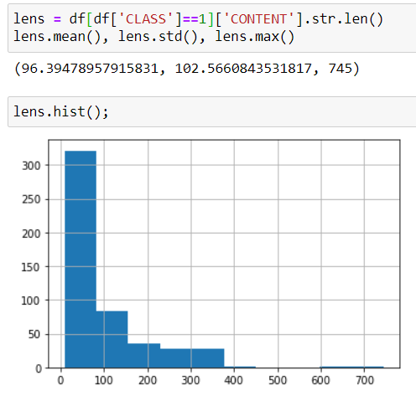
Length of Comments
No Advertisement
Advertisement

Slide 13
Key Insights :
03
Hour wise details
04
02
Distribution of Sample Length
No. of Classes
05
01
Data Representation
No. of Samples

Slide 14
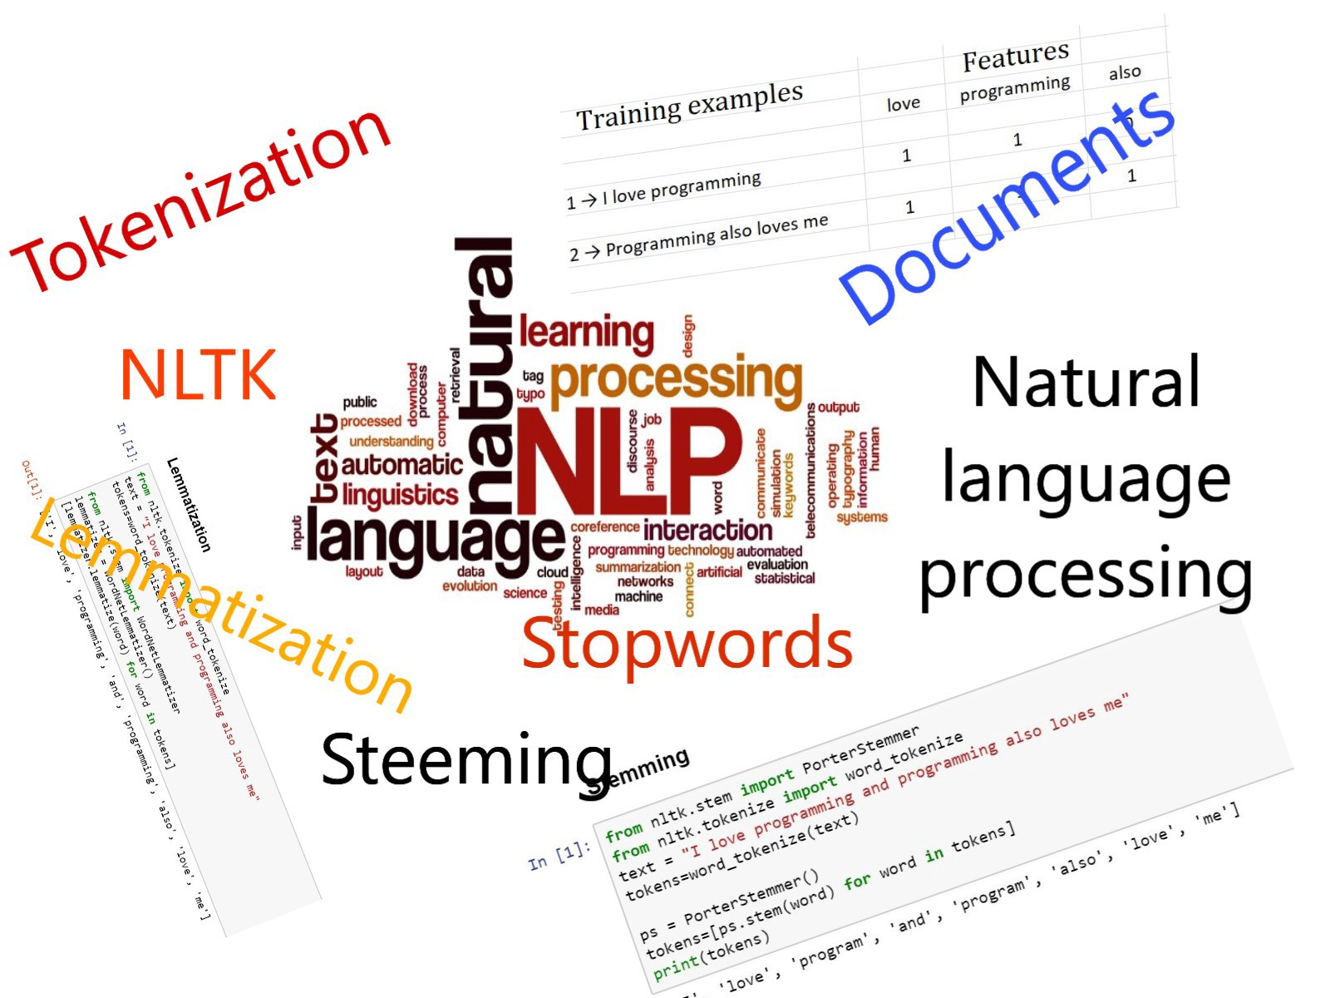

Slide 15
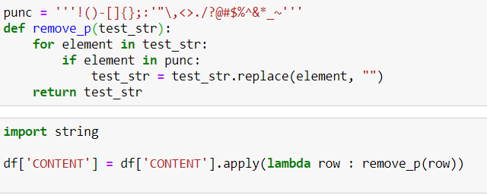

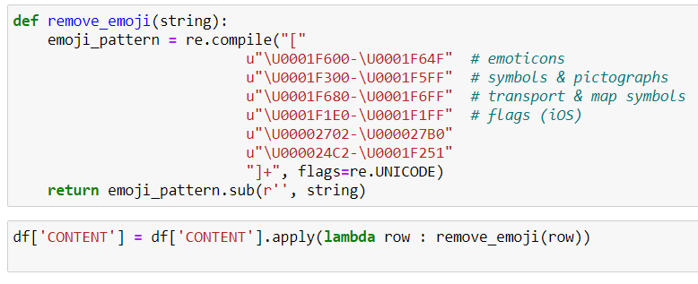
Remove Punctuations and Numeric data:
Remove Emojis:
hello!
hello

Slide 16
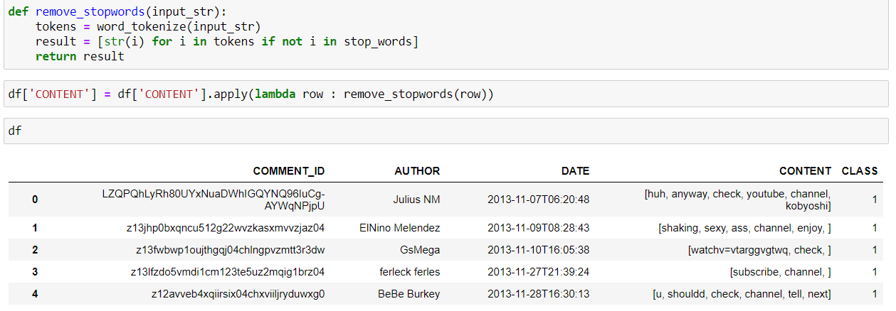
Lower Casing :
Removal of Stop Words:
HELLO
hello

Slide 17
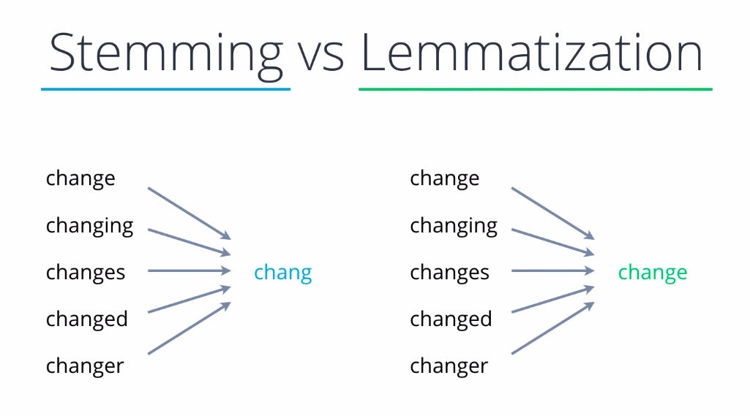
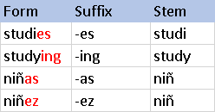
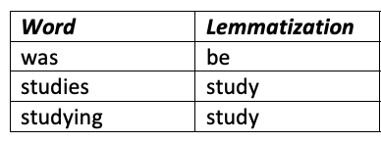
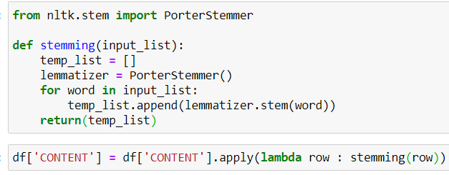
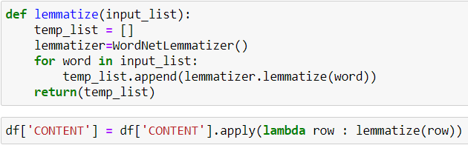

Slide 18
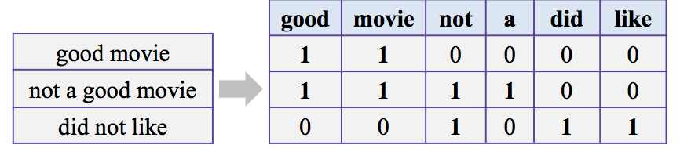
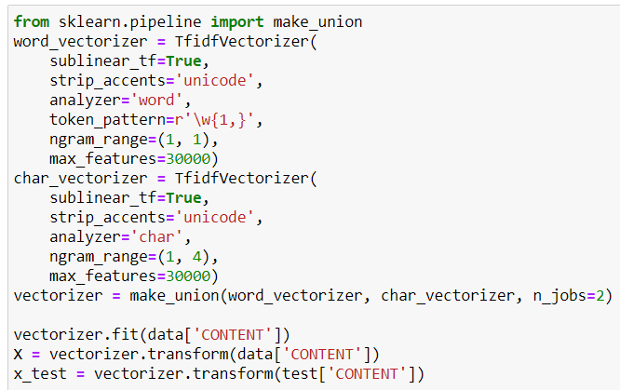
Vectorization:

Slide 19
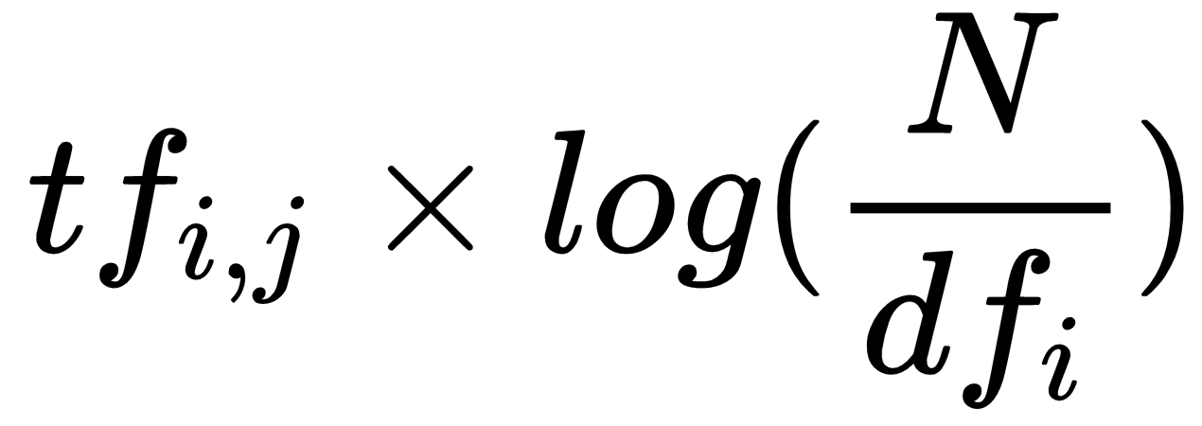
TF IDF :
TF-IDF is a measure of originality of a word by comparing the number of times a word appears in a doc with the number of documents the word appears in.
N: No. of sentences
dfi: No. of sentences containing that word
No. of times term t appears in the Sentence

Slide 20




Model Training :
Training Data
Output Labels
Testing Data
ML Model
Predicted Label

Slide 21
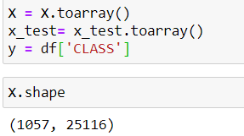
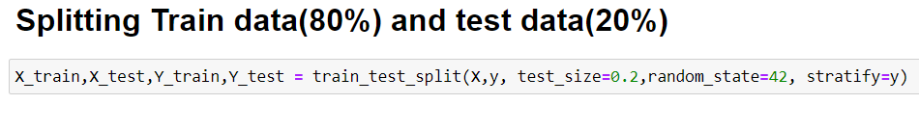
Data Preparation :
80%

Slide 22
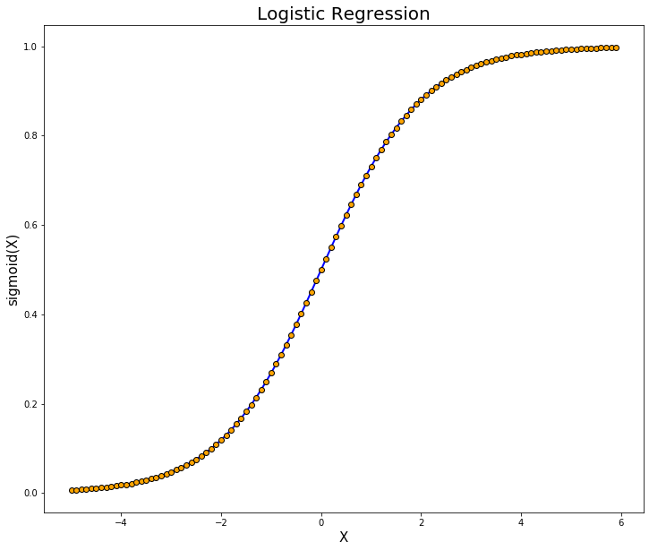
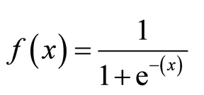
Logistic Regression :

Slide 23
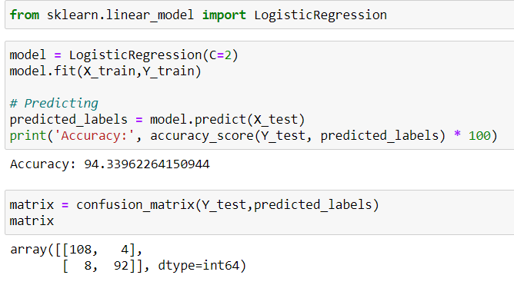
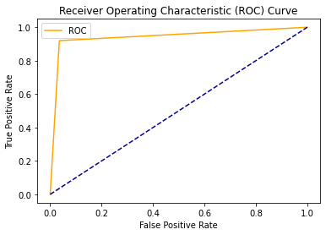
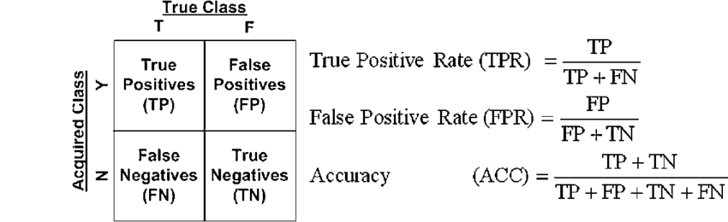
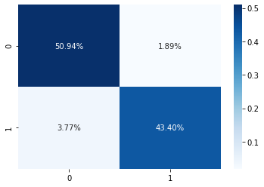
Confusion Matrix

Slide 24
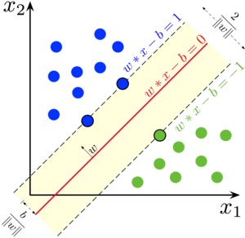
Support Vector Machine :

Slide 25
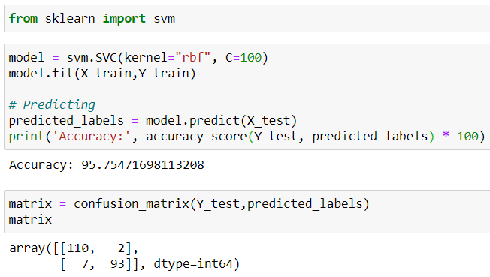
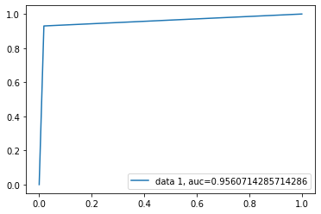
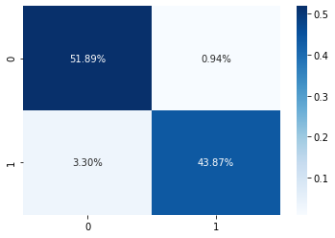

Slide 26
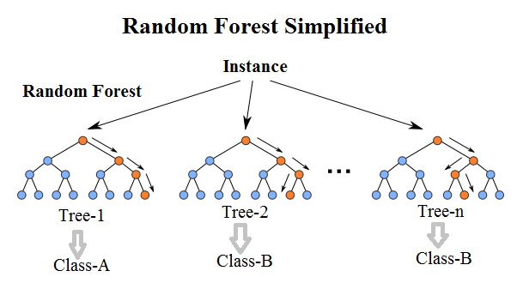
Random Forest :

Slide 27
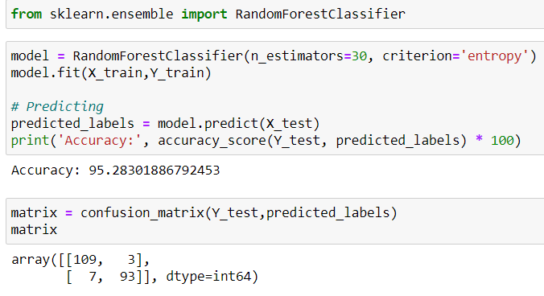
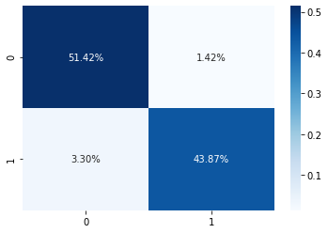

Slide 28

Deployment :

Slide 29

THANK
YOU!

